Slide 1



IDC Digital
Cybersecurity
Practice
© 2024 IDC Technologies. All rights reserved.

Slide 2



$9.5 trillion USD
Predicted global annual cost cybercrime is expected to reach in 2024
eSentire, 2023 Official Cybercrime report
300,000
New malware are created daily
PacketLabs, 2023
Every 39 seconds
A threat actor targets a business cybersecurity infrastructure
PacketLabs, 2023
The Scale of Threats
$4.45 million USD
Global average cost of a company data breach in 2023
IBM, 2023 Cost of a Data Breach Report
© 2024 IDC Technologies. All rights reserved.

Slide 3



IDC Approach and Benefits
We offer solutions that help clients protect business assets and mature their security posture, while proactively detecting, responding and recovering from security events.
We operate around the clock to provide fully customizable, industry aligned managed security solutions including advanced security event monitoring, threat analytics, cyber threat management, and incident response for businesses to meet the increasing market demand in cybersecurity services.
Cost Effectiveness
Scalability
Compliance
Data Privacy
Easy Deployment & Management
Regular Updates
Notes:
We offer solutions that help clients protect business assets and mature their security posture, while proactively detecting, responding and recovering from security events. We also provide round the clock managed services.
The benefits of going with IDC are:
Cost effectiveness: Our services are designed to provide maximum value for your investment. We understand the importance of cost efficiency in today's competitive market, and our solutions are tailored to help you save money while maintaining high-quality standards.
Scalability: Our services can scale according to your needs. This means you can easily adapt to changes in demand without having to worry about outgrowing your services.
Compliance: With our services, you can rest assured that you are always in compliance with relevant regulations and standards. We stay up-to-date with all industry regulations to ensure that your business remains compliant at all times.
Data Privacy: Data privacy is a top priority for us. We understand the importance of protecting your sensitive information and with our services, you can trust that your data is always safe and secure. Easy Development and Management: Our services are designed to be easy to develop and manage. We understand that your time is valuable, which is why we strive to make the process as seamless as possible. Whether you're developing new solutions or managing existing ones.
Regular updates: Security is extremely important in today's digital landscape. That's why we provide regular updates to ensure that your systems are always protected against the latest threats.

Slide 4


IDC Security Strategies
Activate Telemetry and Monitoring
Embrace Shared Intelligence
Prioritize Risk-Based Context Analysis
Assess Organizational Cyber Maturity
Leverage telemetry and active monitoring to gain visibility into threats and vulnerabilities.
Stay informed about the threat landscape and utilize actionable intelligence from trusted sources.
Assess threat importance and prioritize security efforts based on risk context.
Identify gaps in the cyber perimeter, outlining roadmaps to facilitate implementation and optimization of security components.
Achieve Pervasive Defense
Orchestrate and Automate Responses
Empower Developers with Secured Applications
Continuously Empower employee awareness
Implement security measures across your entire ecosystem using an integrated platform.
Automate security responses for faster recovery in case of incidents.
Conduct robust application security tests and educate developers on secure development operations.
Facilitate technical and non-technical employee security awareness and upskill employees with cybersecurity trainings and certificates.
© 2024 IDC Technologies. All rights reserved.
Notes:
These are the strategies that guide our approach to cybersecurity. Activate Telemetry and Monitoring: Our first strategy is to activate telemetry and monitoring. By implementing the ATM solutions, we can proactively detect and respond to security threats before they escalate.
Embrace Shared Intelligence: By collaborating with industry partners and sharing threat intelligence, we can stay one step ahead of cyber threats and better protect our organization and our customers.
Prioritize Risk-Based Context Analysis: We prioritize risk-based context analysis. This allows us to focus our efforts on addressing the most critical security risks.
Assess Organizational Cyber Maturity: It's essential to regularly assess our organizational cyber maturity. By understanding our strengths and weaknesses, we can identify areas for improvement.
Achieve Pervasive Defense: This means implementing security controls across every layer of our organization, from the network to the endpoint, to create a defense-in-depth strategy.
Orchestrate and Automate Responses: By leveraging automation, we can respond to threats more quickly and efficiently, reducing the impact of security incidents.
Empower Developers with Secured Applications: By integrating security into the development process from the beginning, we can ensure that the applications are built with security in mind, reducing the risk of vulnerabilities.
Continuously Empower Employee Awareness: Finally, we continuously empower employee awareness. So, they are equipped to identify and respond to security threats.

Slide 5
© 2024 IDC Technologies. All rights reserved.
Notes:
We understand the importance of collaboration. That's why we have formed partnerships with top security firms and organizations. These partnerships enable us to access the latest threat intelligence and security best practices, enhancing our ability to protect our clients from cyber threats.

Slide 6
IDC Cybersecurity Services Portfolio
Consulting and Advisory
Perimeter and Identity Security
Threat Landscape Analytics
Detection and Incident Response
We help executives develop a cyber risk program in line with the strategic objectives and risk appetite of the organization.
We focus on establishing effective controls around the organization’s most sensitive assets and balancing the need to reduce risk and improve productivity.
Improve visibility of your cyber security posture with services like security risk analysis, threat analysis and intelligence.
We combine proven proactive and reactive incident management processes and technologies to rapidly adapt and respond to cyber disruptions.
Cyber Strategy Consulting
Cyber Strategy, Transformation, and Assessment and Roadmap
Cyber Risk Management and Compliance
Cyber Education and Awareness
Infrastructure Protection
Vulnerability Management
Vulnerability Assessments and Penetration Testing
Identity and Access Management
Information Privacy and Protection
DevSecOps Design
Application Assessments
Threat Analytics and Intelligence Feeds
Data Driven Risk Analytics
Security Information Event Management
Security Orchestration and Automated Response
Cyber Incident Response
Managed Detection Response
Cyber Forensic Services
Contingency and Recovery Strategies
© 2024 IDC Technologies. All rights reserved.
Notes:
Consulting and Advisory: Our consulting and advisory services provide expert guidance and support to help you assess your cybersecurity posture and develop a strategic roadmap to enhance your security posture.
Perimeter and Identity Security: We offer perimeter and identity security solutions to protect your organization's network and sensitive data. Our solutions include:
Threat Landscape Analytics: Our threat landscape analytics solutions leverage advanced analytics and threat intelligence to identify and prioritize potential threats to your organization. By monitoring for suspicious activity and analyzing threat data in real-time, we can detect and respond to threats before they escalate. Detection and Incident Response: In the event of a security incident, our detection and incident response services ensure a swift and effective response. Our team will quickly detect and contain the threat, minimize the impact on your organization, and implement measures to prevent future incidents.

Slide 7



Helping an Existing Bank become more Tech-Proof with Cybersecurity Solutions
The Objective
The Challenge
The IDC Solution
Key Benefits
Upgrading core applications of security and service solutions for a major bank in India.
Integration with large volume of third- party and core APIs with a total of 45 APIs.
Upgrading core applications of security and service solutions for a major bank in India.
Application of best practice security solutions for the bank’s compliance and cybersecurity needs.
​
Centralized management, Security Compliances and Cybersecurity risk mitigation.​
Stress-free operation and management of bank’s cybersecurity operation center with professional manpower and best practices.​
Secure automation and deployment of 30 microservices on multiple environments.
Web Application Firewalls
DevSecOps framework
Encryption of authentication information and payloads
Continuous vulnerability assessment
Coordination with development teams across multiple geographies.
Requirement of cybersecurity operational manpower.
© 2024 IDC Technologies. All rights reserved.

Slide 8

Consulting and Advisory
We help executives develop a cyber risk program in line with the strategic objectives and risk appetite of the organization.
© 2024 IDC Technologies. All rights reserved.

Slide 9
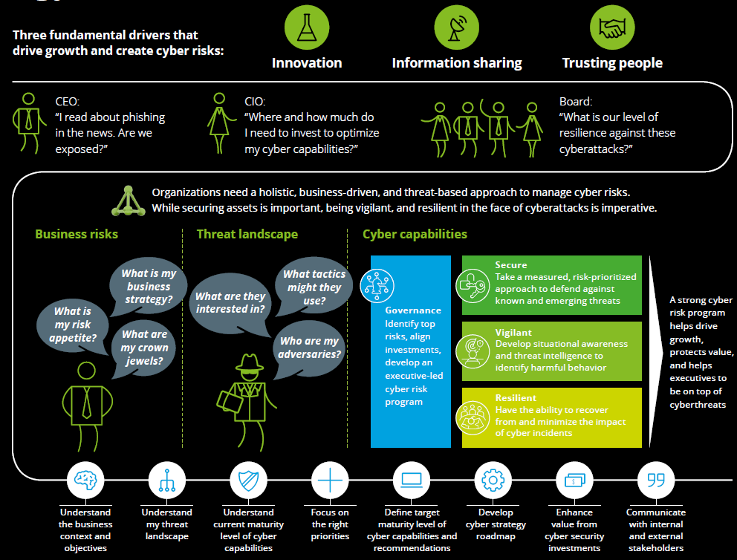
Cyber Strategy Framework (CSF)
Managing cyber risk to grow and protect business value
The IDC CSF is a business-driven, threat-based approach to conducting cyber assessments based on an organization’s specific business, threats, and capabilities. CSF incorporates a proven methodology to assess an organization’s cyber resilience; content packs which enable us to conduct assessments against different standards.
Notes:
Our Cyber Strategy Framework (CSF) is a business-driven, threat-based approach to conducting cyber assessments tailored to your organization's specific business, threats, and capabilities.
We assess your organization's cyber resilience. By understanding your unique business context and threat landscape, we can identify vulnerabilities and prioritize security measures to protect your organization effectively. Benefits of CSF
Business-driven approach
Threat-based assessment
Tailored to your organization's specific needs
Proven methodology
Enables compliance with regulatory requirements and industry standards

Slide 10
Cyber Strategy, Transformation, and Assessments
Challenges
Organizations increasingly depend on complex technology ecosystems for several key purposes: to interact in new ways with customers and third-parties; to use data to improve decision-making; and to increase reach and profitability.
As cyberattacks become more frequent and severe, board members and executives are seeing that technology-based initiatives open doors to cyber risks.
Key Solutions
Cyber Strategy,
Roadmap, and Architecture
Advise | Implement
We define cyber strategies, actionable cyber roadmaps, and reference architectures in line with the findings of a maturity assessment.
Recommendations are based on a defined target state that is determined by the organization’s threat exposure.
Cyber Transformation
Advise | Implement | Manage
We mobilize, manage, and deliver a structured and prioritized program of work to help organizations transform to improved cyber governance, security, vigilance, and resilience.
Cyber Maturity Assessments
Advise | Implement | Manage
Enables organizations to identify and
understand their key business risks and
cyberthreat exposures. This supports
measurement of their cyber maturity,
either using industry-standard frameworks.
Cyber Risk Quantification
Advise | Implement
Provides the information needed to make
security investment decisions. IDC uses
unique methods to quantify both the client’s risk and the expected risk mitigation offered by IDC security investments
© 2024 IDC Technologies. All rights reserved.
Notes:
Use of all the latest gadgets and technologies make a complex technology ecosystem for different purposes: new ways to communication, use data for improved decision making and increase reach and profitability. All these technology based initiatives open doors to cyber risk.

Slide 11

Cyber Risk Management and Compliance
Challenges
Understanding the status of an organization’s security posture requires constant evaluation of evolving risks, security standards, and cyber regulations.
Today’s complex and distributed IT landscape and third-party involvement means organizations must take a structured approach to understanding the road ahead.
Key Solutions
Cyber Risk Management
Advise | Implement
We define framework and methodologies to assess cyber risks for the organization to understand their magnitude and make informed decisions that align the organization’s risk appetite with the risks it faces.
Cyber Risk Dashboarding
Advise | Implement | Manage
We design and implements risk dashboard constituents, including Key Risk Indicators (KRIs) and dashboards to facilitate effective monitoring of cyber risk from the boardroom to the network.
Cyber Insurance
Advise | Implement
Evaluates coverage of existing insurance policies. Determines areas where residual cyber risk could be transferred to an insurer.
Security Control Framework
Advise | Implement
We mobilizes, manages, and delivers a structured and prioritized program of work to help organizations transform to improved cyber governance, security, vigilance, and resilience.
Third-Party Risk Management
Advise | Implement
Customizes services at each step of the third-party cyber risk management lifecycle. Provides end-to-end oversight of the third-party risk management program.
Security and Regulatory Compliance
Advise | Implement
Assists and prepares compliance with national and/or sectoral cybersecurity regulations.
© 2024 IDC Technologies. All rights reserved.
Notes:
Understanding the status of an organization’s security posture requires constant evaluation of evolving risks, security standards, and cyber regulations.
In the key solutions, we work on defining security framework, and methodologies access cyber risks for the organization.
Dashboarding: where we define Key risk indicators and facilitate effective monitoring.

Slide 12

Cyber Education and Awareness
Challenges
Even with excellent people and technology in place, the organization’s own employees are the weakest link when it comes to cybersecurity. The so-called insider threat is real. Building secure defenses against outside threats is not enough if data is leaked from within an organization.
Key Solutions
Insider Risk
Advise | Implement
We help organizations identify, monitor, and manage the main sources of insider threat. We help to establish Potential Risk Indicators (PRIs) and create awareness of the main indicators of maturity in managing insider risk.
Cyber Security Awareness Program
Advise | Implement | Manage
We understand the current state of a company’s awareness level, defines a strategy, and develops a recognizable awareness campaign, multimedia content package, and communication tools.
Technical Cyber Training
Advise | Implement
We deliver both introductory and highly specialized technical training in cybersecurity, either on-site or through a purpose-built online platform. Our catalog of courses covers areas such as: Hacking, Secure Development, Forensics, Reversing, Industrial Control System (ICS) security, and Incident Response.
© 2024 IDC Technologies. All rights reserved.
Notes:
Even with excellent people and technology in place, the organization’s own employees are the weakest link when it comes to cybersecurity.

Slide 13

Perimeter and Identity Security
We focus on establishing effective controls around the organization’s most sensitive assets and balancing the need to reduce risk, while enabling productivity, business growth, and cost optimization objectives.
© 2024 IDC Technologies. All rights reserved.

Slide 14
Infrastructure Protection
Challenges
Hyper-connectivity is creating a new era for cyber infrastructure. Ever more connected devices pose new cybersecurity challenges for public and private-sector organizations as the volume of threats to their infrastructure rises.
Devices connected to corporate infrastructures need to continuously acquire, store, and use large amounts of data, a significant proportion of which will be sensitive. Protecting this data against cyberattack is of paramount importance.
Key Solutions
IoT Strategy, Roadmap, and
Architecture
Advise | Implement | Manage
Reviews industrial and consumer product codes and delivers secure development practices to enhance clients’ capabilities in implementing next-generation connected products. We help organizations undertake readiness assessments, align their IoT security vision with their overall mission and vision statements, build IoT roadmaps and adapt traditional governance models to new IoT developments.
Cloud Security
Advise | Implement | Manage
Evaluates client requirements, assesses
cloud usage, builds the business case
and cloud roadmaps, and assists with
cloud vendor evaluation.
Network Strategy and
Optimization
Advise
Analyzes client infrastructure to identify and remedy the configuration of network components and help clients design their network architecture into secure zones.
© 2024 IDC Technologies. All rights reserved.
Notes:
Protecting the organization's infrastructure is crucial in today's rapidly evolving threat landscape. At IDC, we offer comprehensive infrastructure protection services to safeguard your critical assets. Challenge: Hyper-connectivity is creating a new era for cyber infrastructure.

Slide 15
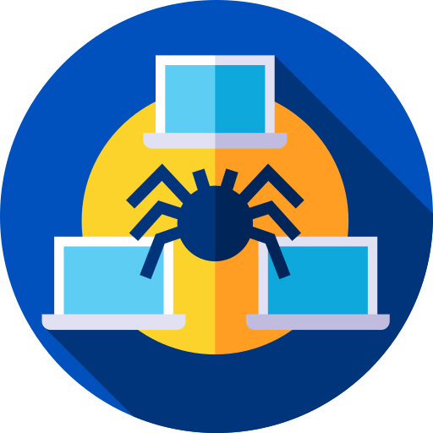
Vulnerability Management
Challenges
Businesses rely on a stable and secure IT environment as the foundation for driving new digital innovations, and products.
New security vulnerabilities are published daily, and hackers are constantly looking for ways to gain access to systems and data.
Identifying, managing, and correcting vulnerabilities in an environment that consists of multiple applications, systems, and locations is a significant management challenge
Key Solutions
Vulnerability Assessments
Implement | Manage
Uses known hacking methods and vulnerabilities, tests the security of applications and IT systems, and achieves increased levels of security. IDC can undertake this work fully on behalf of organizations or complement organization’s internal vulnerability assessment team.
Tabletop Exercises
Manage
Hacking and Phishing as a service to provide regular insight into an organization’s potential vulnerabilities. Many organizations perform security tests only once, while cyber criminals are constantly seeking to find and exploit new vulnerabilities.
Vulnerability Remediation Support
Implement | Manage
Configures and manages vulnerability management solutions providing insight into the business-relevant vulnerabilities that matter.
© 2024 IDC Technologies. All rights reserved.
Notes:
Effective vulnerability management is essential to protect your organization from cyber threats. At IDC, we offer comprehensive vulnerability management services to help you identify, prioritize, and remediate security vulnerabilities across your infrastructure.
Challenge: New vulnerabilities are publishing everyday, and hackers are constantly looking for a way to gain advantage.

Slide 16

Application Protection
Challenges
Applications form a major part of every IT landscape. Ensuring they are protected requires secure design, implementation, and configuration. Testing of the protection requires robust processes, dedicated resources, and a skilled team.
Many organizations find setting up such processes and acquiring and maintaining the required skills and knowledge to be a major challenge.
Key Solutions
Enterprise Application Security
Advise | Implement | Manage
Assesses the current state of an organization’s applications and the security controls on the application layers for enterprise systems.
Source Code Review
Manage | Implement
Analyzes application source code to test for common mistakes. The analysis can be conducted through one-off application assessments or as an integral part of an organization’s software development process.
Secure by Design: Secure SDLC
Implement | Manage
We assess an organization’s software development life cycle (SDLC) to determine if security is properly incorporated. In addition, we help organizations embed Secure by Design principles and controls.
Implementation and Deployment
Implement | Manage Through our partnerships ImmuniWeb and Resecurity, we provide extensive application testing from source code to runtime levels, conducting manual and automated white, grey and black-box penetration tests through emulators.
© 2024 IDC Technologies. All rights reserved.
Notes:
Securing your applications is critical to safeguarding your organization's data and assets. At IDC, we offer comprehensive application protection services to help you mitigate risks and ensure the security of your software applications.

Slide 17

Identity and Access Management
Challenges
The traditional network perimeter has faded. In response, organizations are increasingly focusing on user identity assurance and information access controls.
Identity and Access Management (IAM) provides tools, processes, and methods to enhance the security of online transactions while minimizing friction in the user experience. IAM also provides a trusted environment for omni-channel communication between users (customers, business partners, and employees) and IT platforms.
Key Solutions
Current State Assessments for IAM Components
Advise
Assesses the current maturity of IAM-related controls and pinpoints key improvement areas.
IAM Functionality Design and
Preparation for Implementation
Advise | Implement
Formalizes requirements, designs a fitting solution landscape by selecting the most appropriate solution set, and transforms the organization and its processes to optimize returns on IAM investments.
IAM Platform Deployment
Implement
Makes the IAM vision a reality by implementing IAM solutions to support your IAM processes with key technology partners (SailPoint, OKTA, CyberArk, and ForgeRock).
Reach of IAM
Manage
Integrates business applications with the IAM platform to increase the reach of automated controls.
© 2024 IDC Technologies. All rights reserved.

Slide 18
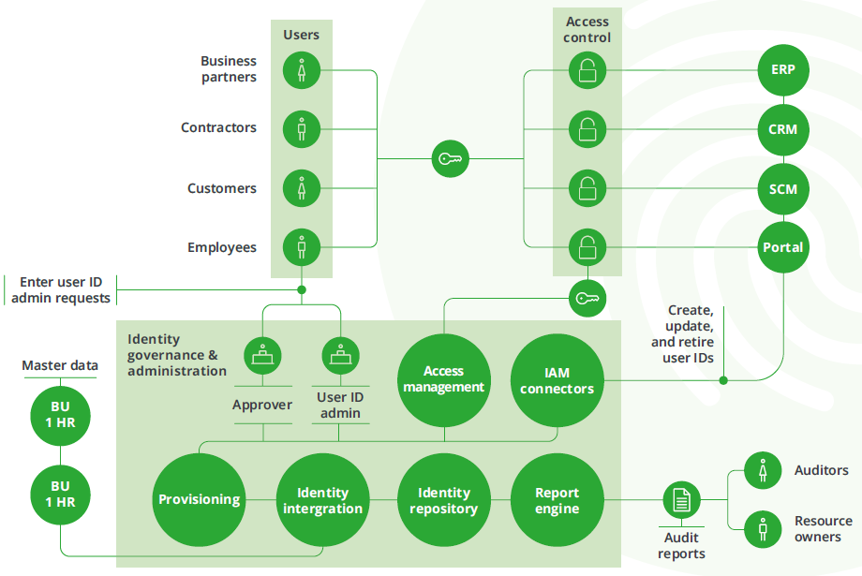
Identity and Access Management Components
Key Differentiators
Business and user-centric view of IAM.
Experience of global best practices and IAM solution architectures.
Solution partner network with major IAM capability providers.
© 2024 IDC Technologies. All rights reserved.

Slide 19

Information Privacy and Protection
Challenges
Organizations need to be able to use, analyze, and share their data while ensuring compliance with invasive regulatory control and customer/employee privacy expectations.
Greater reliance on effective data use, combined with increased regulation and control requirements, such as General Data Protection Regulation (GDPR), puts significant operational pressure on organizations.
This requires a holistic and integrated data privacy approach to an environment that is often highly segmented.
Organizations are expected to keep personal and corporate data confidential, yet data breaches still occur. These can result in financial loss, regulatory sanction, and reputation damage.
Common challenges are identifying organization’s business critical information and ensuring it is adequately protected in a world where the quick exchange of information is integral to business success.
Key Solutions
Privacy/GDPR Maturity Assessments and Roadmap
Advise | Implement
Assesses and identifies the current state of an organization’s GDPR readiness. This includes a prioritized and risk-based roadmap that clearly identifies actionable mitigating measures and short-term fixes.
Implementation and Deployment of Data Protection solutions
Implement | Manage
We leverage cutting-edge solutions such as Azure Information Protection and Galaxkey that ensure sensitive data remains secure at rest and in transit. We assist you to unlock the maximum capability for an efficient governance process which does not make securing your data a cumbersome task.
© 2024 IDC Technologies. All rights reserved.

Slide 20

Threat Landscape Analytics
We integrate threat data, IT data, and business data to equip security teams with context-rich intelligence to proactively detect and manage cyberthreats and respond more effectively to cyber incidents.
© 2024 IDC Technologies. All rights reserved.

Slide 21

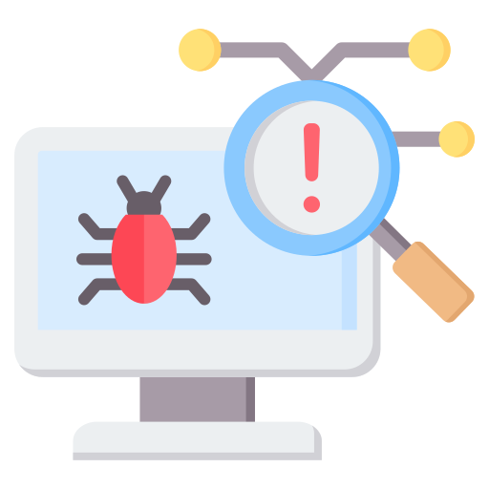





IDC Managed Security Services
Security Information and Event Management
Real-time monitoring, correlation, and analysis of security events across enterprise assets.
This includes:
Vulnerability Management
Managing the full vulnerability life cycle from identifying to managing execution of remediation, to reporting.
Implementation Services
Implementing and managing tools, technologies, and processes for risk-aligned controls development and operations support.
24×7 logging, monitoring, and alerting
Advanced 24x7 security monitoring for early threat detection and mitigation. Through rapid detection, organizations can stop an attack before it impacts business services.
Customized to client-owned or wholly managed by IDC
Fully augmented-operation model that works with your current systems or is wholly owned and managed by us based on business needs. We right size our solution for your business.
Security Tools Management
Managing anti-virus solutions, perimeter security tools, and other preventative and detective solutions.
Onsite Security Operations
Deploying our experienced staff to work with you to enhance your current information security program, or to augment your staff where gaps might exist.

Slide 22
Advanced Threat Readiness and Preparation
Challenges
Threat techniques evolve daily in volume, intensity, and complexity as hackers seek new vulnerabilities in software to compromise key systems across organizations.
Carrying out occasional, intermittent compliance-focused technical security assessments is not enough. Much more is required to understand if organizations can become compromised.
Key Solutions
Advanced Threat
Simulation / Red Teaming
Advise | Implement
Simulates comprehensive cyberattack that tests the organization’s prevention, detection, and response mechanisms
and incorporates three core elements of security: physical, cyber, and human.
The red team will perform realistic attack scenarios to achieve predefined objectives, using social engineering,
phishing, physical penetration testing, and network exploitation.
Cyber Compromise Assessment
Advise | Manage
Examines an organization’s network to identify potential compromised devices by monitoring for malicious network traffic and suspicious network activity.
Threat Readiness Advisory and
Remediation
Advise | Implement | Manage
Helps most mature organizations deal with advanced threats guiding improvements of ROI on existing detection technologies. By improving interaction between systems, applying realistic use cases, and staff training.
© 2024 IDC Technologies. All rights reserved.

Slide 23

Threat Intelligence and Analysis
Challenges
Key Solutions
Understanding the cyberthreat landscape is difficult as threats are continuously evolving.
An integral approach to identifying threats requires significant resources to gather, filter, and interpret threat information from a wide variety of sources
Cyberthreat Intelligence
Advise | Implement | Manage
Looks for potentially threatening events taking place outside the organization’s perimeter and provides custom insights in line with the organization’s strategic and intelligence requirements.
Security protection capability | Our expertise | Other partners
Endpoint protection | ✔✔ | ✔✔
Mobile & BYOD protection | ✔✔ | ✘
Device encryption | ✔ | ✔
Email protection | ✔ | ✔
MDR & XDR | ✔✔ | ✔
Runtime defense | ✔ | ✔
Network protection (cloud, on-premise, hybrid) | ✔✔ | ✔
Physical network security components | ✔ | ✘
Server workload protection | ✔✔ | ✔
Ransomware protection | ✔ | ✔
Java application protection & integrity monitoring | ✔✔ | ✘
Web application and API protection & integrity monitoring | ✔✔ | ✘
Implementation and Deployment
Implement | Manage Through our partnerships with Sophos, Virsec, and Microsoft, we provide an all-encompassing specter of endpoint, network, and data security analysis software that the SOC can effectively leverage to manage, monitor, and analyze components
© 2024 IDC Technologies. All rights reserved.

Slide 24
Threat Intelligence to Enhance your SOC
1
Organizations identify threats 10 times faster and resolve them 63 percent quicker using threat intelligence.
Time threats are identified before becoming impactful
6 HOURS
Time to resolve identified issues
15.6 HOURS
SOC without TI
REACTIVE APPROACH
2
Threat intelligence enables security teams to identify 22 percent more threats before they become impactful.
3
Leveraging threat intelligence can save $39,638 USD per team member per year.
98.2 HOURS
SOC with TI
PROACTIVE APPROACH
Time threats are identified before becoming impactful
 | Before TI | After TI | Difference | Benefit (%)
Time threats are identified before becoming impactful (hours) | 6 | 98.2 | 92.2 | 1,637
Time to resolve issues (hours) | 15.6 | 5.7 | 9.9 | 63
Staff time cost for security resolution | $241,100 | $54,000 | $187,400 | 78
5.7 HOURS
Time to resolve identified issues
© 2024 IDC Technologies. All rights reserved.

Slide 25
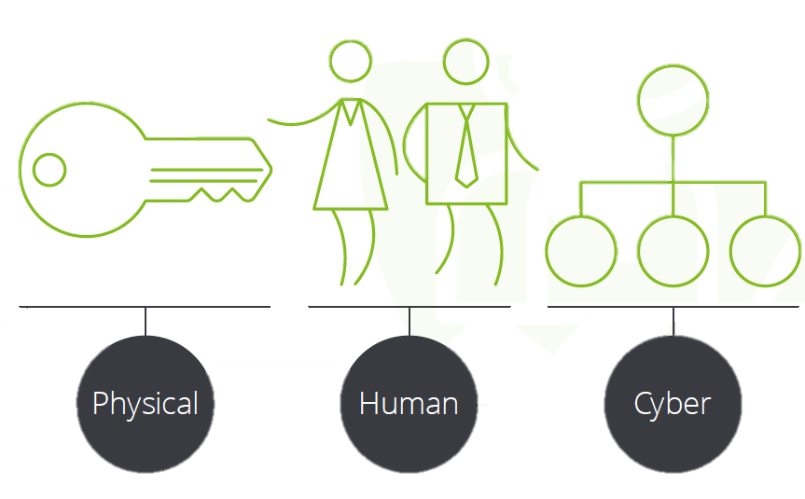
Threat Analytics
Key Differentiators
Identify the weakest link with IDC services
With the IDC service-delivery model, organizations benefit from seamless integration with their vulnerability lifecycle management tasks.
Our advanced services enable organizations to address emerging threats from new and disruptive technologies.
We work with the latest open source and commercial technologies and can work with any technology an organization might already have deployed.
© 2024 IDC Technologies. All rights reserved.

Slide 26

Cyber Risk Analytics
Challenges
The greatest challenge organizations face today is the sheer abundance of threats, which makes it difficult to focus on those that pose the highest immediate risk.
Key Solutions
Monitoring and Correlation
Manage | Implement
Enables organizations to view what is happening in cyberspace through advanced analytics. Either through monitoring and correlation of events, log collection with IDC Managed Security Services (MSS), or through Cyber Risk Analytics and behavior analytics tools deployed on-site
SIEM Intelligence
Advise | Implement
Improves SIEM services by assessing an organization’s SIEM and analytics maturity and governance. We design a SIEM evolution roadmap, and design and develop use cases, as well as assist in SIEM provisioning.
© 2024 IDC Technologies. All rights reserved.

Slide 27

Security Operations Center (SOC)
Challenges
Organizations need to develop their information security capabilities, to respond faster, work more efficiently, and protect their core business. To achieve this, it is imperative that they have a mature SOC capability.
Specialist skills and technology platforms are essential. Organizations often find it difficult to build, maintain, and resource a SOC.
Key Solutions
SOC Capability Design and
Deployment
Advise | Implement
Assesses the people, process, and technology aspects of an organization’s SOC. Uses industry best practices to design and deploy a tailored SOC solution. This enables organizations to identify and respond to the most severe threats they face.
SOC Cyber Security Dashboard
Advise | Implement | Manage
Defines and develops cyber risk metrics, indicators, and dashboards to provide insight into the operational effectiveness of the SOC.
© 2024 IDC Technologies. All rights reserved.

Slide 28

Detection and Incident Response
We combine proven proactive and reactive incident management processes and technologies to rapidly adapt and respond to cyber disruptions whether from internal or external forces.
© 2024 IDC Technologies. All rights reserved.

Slide 29
Cyber Incident Response
Challenges
Cyberthreats are constantly evolving and increasing in volume, intensity, and complexity.
It has become more likely that an attack can penetrate an organization’s defenses and security controls. When this happens organizations must respond fast, thoroughly, and decisively
Key Solutions
Cyber Forensic Services
Advise | Implement | Manage
Investigates cybercrimes to determine the nature, extent, means, and origin of an incident. This supports organizations in any legal actions they may need to take.
IT Resilience and Recovery
Advise
Provides support in enacting your contingency plans and returning technical operations to a normal state after a cyberattack or other disruption.
Key Differentiators
IDC’s experience in incident and crisis management minimizes the time and resources needed to resolve an emergency.
IDC’s understanding of business and risk allows us to respond to incidents from both a technical and a strategic perspective.
© 2024 IDC Technologies. All rights reserved.

Slide 30

Thank You!
Email us
info@idctechnologies.com
projects@idctechnologies.com
Follow us
facebook.com/idctechnologies
twitter.com/idctechnologies
© 2024 IDC Technologies. All rights reserved.

Slide 31

Software & Infrastructure Security
What We Provide
Federated Identity
We safeguard your organization's infrastructure from a multitude of cyber threats. Our suite of advanced cybersecurity services covers every aspect of your organizational security needs, ensuring robust protection from network perimeter to web applications and data.
With encryption solutions such as BitLocker and Galaxkey, we secure your sensitive data, both at rest and in transit, providing peace of mind against unauthorized access.
Our cloud security offerings, leveraging Microsoft security suite, Virsec, and Sophos, protect your cloud environment from a wide range of threats, including malware, phishing attacks, and data breaches.
Furthermore, our device management services ensure that all devices within your network are properly configured, monitored, and secured against potential vulnerabilities. With antivirus solutions like Microsoft Defender and network protection hardware from Sophos, we provide real-time threat detection and response capabilities, mitigating risks effectively.
Through a combination of robust encryption, telemetry, automation, and other SOC tools, we offer end-to-end security solutions tailored to your organizational needs.
CASB
Cloud Security
Privileged Access Management
Identity Management
Identity & Access Management
Security Architecture
Data Protection
Access Control
Network Design
Cybersecurity Domains
Secure System Build
Security Engineering
Baseline Configuration
Cryptography
Secure Application Development
© 2024 IDC Technologies. All rights reserved.

Slide 32

Posture & Risk Assessment
What We Provide
We ensure the security and resilience of your software applications against cyber threats. Our suite of advanced cybersecurity services provides comprehensive solutions to fortify your defenses.
We leverage cutting-edge platforms like ImmuniWeb and Resecurity, our source code reviews meticulously analyze your codebase, identifying vulnerabilities and weaknesses that could be exploited by attackers.
Our penetration testing services simulate real-world cyber attacks, uncovering hidden vulnerabilities and assessing the effectiveness of your security controls.
Additionally, our maturity and risk assessments provide valuable insights into your organization's security posture, enabling targeted risk mitigation strategies. With our Vulnerability Assessment and Penetration Testing (VAPT) services, we ensure that your applications and infrastructure are resilient against potential threats.
Assets Inventory
Data Centric Risk Assessment
3rd Party Risk
Vulnerability Scan
Social Engineering
Risk Assessment
Black-box
Cybersecurity Domains
Source Code Scanning
White-box
Grey-box
Penetration Test
Blue Team
Infrastructure
Application
Red Team
© 2024 IDC Technologies. All rights reserved.

Slide 33

Secure Development Operations
What We Provide
Compliance as Code
Container Security
We help you enhance the security of software development lifecycle and streamline the process. Our suite of advanced cybersecurity solutions offers a range of services designed to fortify your defenses and improve efficiency.
With automated testing, we conduct comprehensive security assessments of your applications, identifying vulnerabilities and weaknesses early in the development cycle.
Our container security services ensure that your containerized applications are protected against threats, with robust security measures in place throughout the deployment process.
By integrating security checks and tests into your Continuous Integration/Continuous Deployment (CI/CD) pipelines, we automate security processes, enabling rapid and consistent delivery of secure code.
Embracing the Shift left approach, we shift security practices left in the development lifecycle, empowering you to detect and remediate vulnerabilities proactively.
Additionally, our Security as Code and Compliance as Code services enable you to manage security policies and compliance requirements as code artifacts, ensuring consistency and scalability across your infrastructure.
Security as Code
Immutable Infrastructure
DevSecOps
Automation
Continuous Monitoring
Cybersecurity Domains
© 2024 IDC Technologies. All rights reserved.

Slide 34

Governance & Compliance
What We Provide
We ensure that your organization is compliant with industry regulations, standards and is aligned to your organization’s security objectives.
Through meticulous policy reviews, we ensure that your security policies are up-to-date and aligned with industry best practices.
Our gap analysis identifies discrepancies between your current state and desired security objectives, guiding targeted remediation efforts to close these gaps effectively.
We help you navigate the complex landscape of regulatory requirements and industry standards, ensuring that your organization remains resilient against cyber threats.
Audit
Industry Specific
Governance
Federal
Compliance & Enforcement
Laws and Regulations
State
Cybersecurity Domains
Guideline
Executive Management
Company’s Written Supervisory Procedures (WSPs)
Reports and Scoreboards
Risk Informed
Policy
Standard
KPIs/KRIs
Procedure
© 2024 IDC Technologies. All rights reserved.

Slide 35

Managed Security Services
Recovery
Detection
Protection
What We Provide
Prevention
Active Defense
With our suite of advanced cybersecurity solutions, we offer cutting-edge capabilities to safeguard your digital assets effectively and streamline incident response processes.
We use data-driven risk analytics to establishing a robust Security Operations Center (SOC), we provide the expertise and technology needed to stay resilient against evolving threats.
Our Security Orchestration, Automation, and Response (SOAR) platform enables seamless coordination of incident response activities, improving efficiency and reducing response times.
Our Threat Intelligence services deliver actionable insights into emerging threats, empowering you to stay one step ahead of cyber adversaries. We help you strengthen your cybersecurity posture and protect your organization's reputation and assets with confidence.
Security Operations
SOC
SIEM
Vulnerability Management
Data Leakage
Incident Response
Cybersecurity Domains
Breach Notification
Investigation
Containment
Forensics
Threat Intelligence
External
Internal
Contextual
IOCs
Intel. Sharing
© 2024 IDC Technologies. All rights reserved.

Slide 36

Continual Improvement
Certification
What We Provide
Training
Career development
Our tailored services are designed to continually improving your organization's cybersecurity posture and fostering a culture of awareness among your employees
Our team specializes in developing engaging awareness campaigns, multimedia content packages, and communication tools that resonate with your workforce, instilling a proactive approach to cybersecurity at every level.
We offer a comprehensive range of training through on-site workshops as well; we provide continuous training opportunities to empower your employees with the knowledge and skills needed to detect and mitigate cyber threats effectively.
With our focus on continual improvement and cybersecurity training and awareness, your organization will be better equipped to address evolving challenges and safeguard its valuable assets.
Cybersecurity Domains
User education
Training (new skills)
Awareness (reinforcement)
© 2024 IDC Technologies. All rights reserved.

